Slide 1
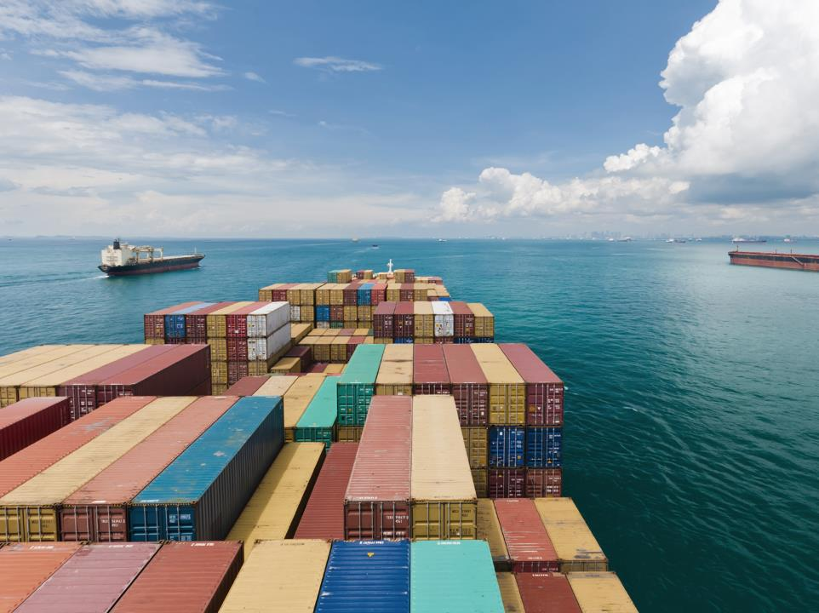
Update on the legally binding instrument under UNCLOS on the conservation and sustainable use of marine biological diversity of areas beyond national jurisdiction (BBNJ)
Presentation during the thirty-first session of the Assembly
Frederick J. Kenney, Director, LED
Dorota Lost-Sieminska Deputy Director/Head, Legal Affairs Office, LED
Fredrik Haag, Head, Office for the London Convention/Protocol and Ocean Affairs, MED

Slide 2
Background – Why a BBNJ treaty?
2015: UNGA decides to develop an international legally binding instrument on BBNJ, following almost a decade of discussions
Objective: Conservation and sustainable use of marine biological diversity of areas beyond national jurisdiction
Focusing on five main areas:
  Marine genetic resources (MGR);
  Area-Based Management Tools (ABMT);
  Environmental impact assessments (EIA);
  Capacity-building and the transfer of marine technology (CB&TT);
  Cross-cutting issues: institutional arrangements, the clearinghouse mechanism, general elements, principles and approaches and international cooperation

Slide 3
Background, continued
In 2017, the General Assembly decided to convene an intergovernmental conference (IGC), to develop the instrument
The Secretariat has participated throughout the preparatory phase leading up to this conference (since 2008)
2016-2017: Preparatory Committee (four sessions). Secretariat attended, providing written input, statements and organized side-events (jointly with Member States and ICS) to inform of IMO’s work

Slide 4
Background, continued
IGC-1: 4 to 17 September 2018
IGC-2: 25 March to 5 April 2019
IGC-3: 19 to 30 August 2019
The fourth session is scheduled for 23 March to 3 April 2020
All UN Member States are represented at the Conference and the negotiations are undertaken between the representatives of those States
Groups of States (such as Group of 77, African Group, SIDS) play a big role in the negotiations
IMO, same as other organizations, like FAO, IOC, ISA, have an observer status at the Conference

Slide 5
Current state of discussions following IGC-3
Addressed and made progress on the main topics:
  Marine genetic resources (MGR);
  Area-Based Management Tools (ABMT);
  Environmental impact assessments (EIA);
  Capacity-building and the transfer of marine technology (CB&TT);
  Cross-cutting issues: institutional arrangements, the clearinghouse mechanism, general elements, principles and approaches and international cooperation;
Agreed that the new instrument should:
  be fully consistent with UNCLOS;
  not undermine existing relevant legal instruments and frameworks and relevant global, regional and sectoral bodies, such as IMO

Slide 6
Summary: Area Based Management Tools under the BBNJ instrument
Area Based Management Tools (ABMTs) relate to the establishment of e.g. marine protected areas (MPAs)
May affect areas established by IMO such as PSSAs, Special Areas, routing measures, etc.
It is important to ensure that measures adopted by BBNJ will not conflict or interfere with measures adopted by IMO, as well as internationally established legal framework on navigation rights.

Slide 7
Environmental Impact Assessments
Environmental Impact Assessments (EIAs) are not explicitly referenced in IMO’s regulatory framework in a formal sense. However, the process of evaluating the impacts of activities regulated by IMO are embedded in several ways.
Discussions at the IGC includes a variety of options for possible EIAs under the new BBNJ treaty
Possible list of activities which do not require EIA – shipping (?)
Any new tools developed under the instrument should be complimentary in nature to the existing IMO tools, standards and guidelines, and work in tandem with the existing IMO regime.

Slide 8
Capacity building and the transfer of marine technology
States, directly or through competent international organizations, shall promote cooperation in CB&TMT to assist developing countries in achieving the objectives of the instrument
Promoting technical cooperation constitutes a major part of the IMO’s work, thus IMO should be recognized as one of the competent organizations

Slide 9
Institutional arrangements – decision making body
BBNJ decision making body: Conference of Parties
Scientific/technical body (GESAMP)
Other subsidiary bodies
Decision making body will be responsible for cooperation and coordination with relevant global, regional and sectoral bodies such as IMO

Slide 10
Institutional arrangements - Secretariat
BBNJ secretariat, options:
  New independent secretariat
  DOALOS
  IOC/UNESCO
  Shared secretariat? Role for IMO?
The secretariat shall manage the clearing-house mechanism and coordinate consultation with relevant organizations on ABMTs and EIAs

Slide 11
Treaty law
Currently: diplomatic conference
The new instrument will be adopted under UNCLOS
Open to all States
Final clauses: depositary, EIF still to be decided
Relevant global, regional and sectoral bodies will be responsible for the implementation and enforcement where appropriate

Slide 12
IMO Secretariat approach to the IGC
Throughout the PrepCom and the IGC, the IMO Secretariat has contributed to and organized several side events, providing input on IMO's work
Side events organized together with several IMO Member States, ICS and Norwegian Shipowners Association
The Secretariat has made statements, also together with other UN entities
IMO Secretariat works closely with United Nations and other specialized agencies (e.g. the FAO, ISA, UNEP, IOC of UNESCO and ILO) to coordinate the position and to ensure that the new instrument will not impact or impede the roles and responsibilities of other relevant global, regional and sectoral organizations.

Slide 13
Next steps
The fourth and final session (IGC-4) will be held from 23 March to
3 April 2020
Will consider a revised draft text of the future treaty, which has been made available last week, at:
https://www.un.org/bbnj/content/fourth-substantive-session
The Secretariat will continue to follow the process and participate in the meetings, and will inform IMO Member States of the developments on a regular basis (MSC, MEPC, Council)

Slide 14
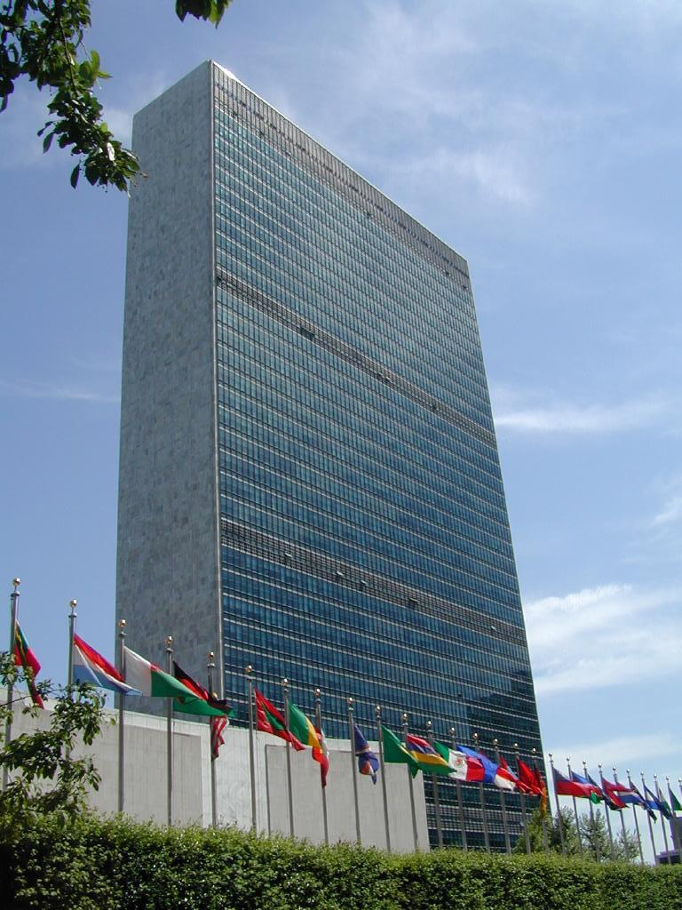

Slide 15
Considerations for IMO Member States
As the BBNJ negotiations draw to a close, IMO delegations need to be aware of those areas where there may be a potential impact on the work of IMO.
Some proposed procedures under the BBNJ instrument could inflict on the role and mandate of IMO, its instruments and processes
Ensure that IMO Member States positions at the BBNJ Conference are in line with their interests at IMO

Slide 16
Considerations for IMO Member States
To assist IMO Member States, the Secretariat provided a summary of the most relevant provisions to C 122 (see C 122/INF.7):

Slide 17
What happens next?
Once the Secretariat has analysed the new text, an information session for Member States will be held (January).
The Secretariat will attend IGC-4 in late March/early April.
Further information will be provided to Council, MSC and MEPC in 2020.

Slide 18
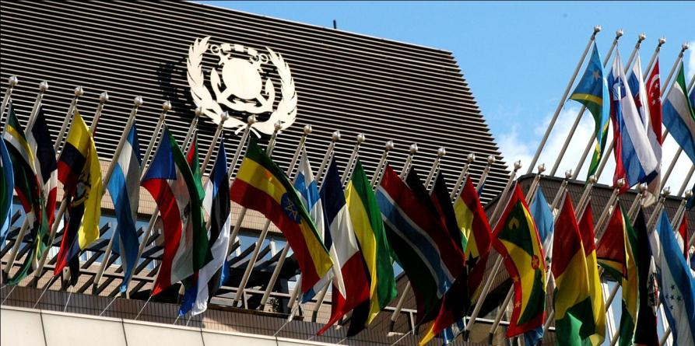

Thank you for listening
www.imo.org

